Slide 1
The 1st year annual review Classification of cells using single cell transcriptomics data and machine learning
Reporter: Jiahui Zhong
Student Number: 20120196
Supervisor: Prof. Vladimir Brusic
Dr. Heshan Du
Dr. Xiaoling Liu
2019. 09. 25

Slide 2
Background
Aim & Objectives
Progress
Conclusion
Future work
Publication

Slide 3
Background

Slide 4
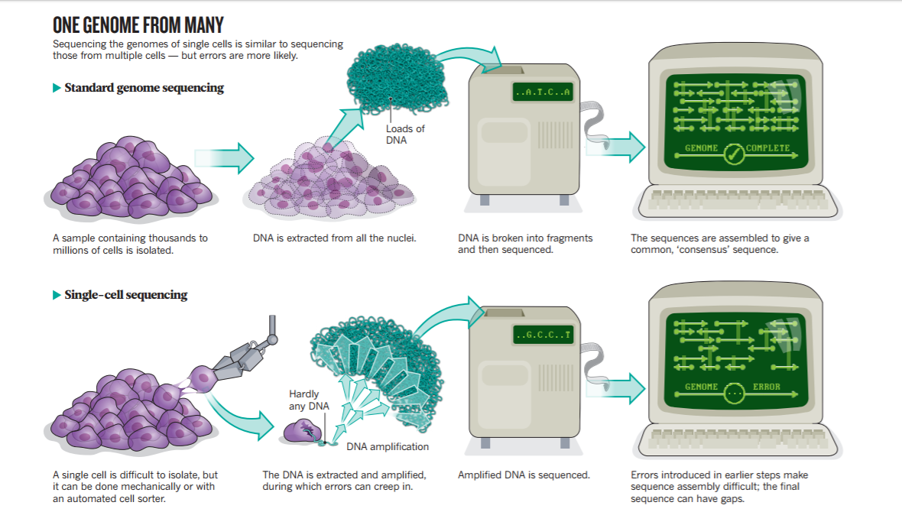
Single cell RNA sequencing
Image credit: Owens, Nature 491(7422):27-29, (2012)

Slide 5
Single cell RNA sequencing
Heterogeneity of tissue samples
Different cells from different tissue have heterogeneous sequences/activities:
Different species
Different tissue
Different cell types
Different mutations
Different sub-clones
...

Slide 6
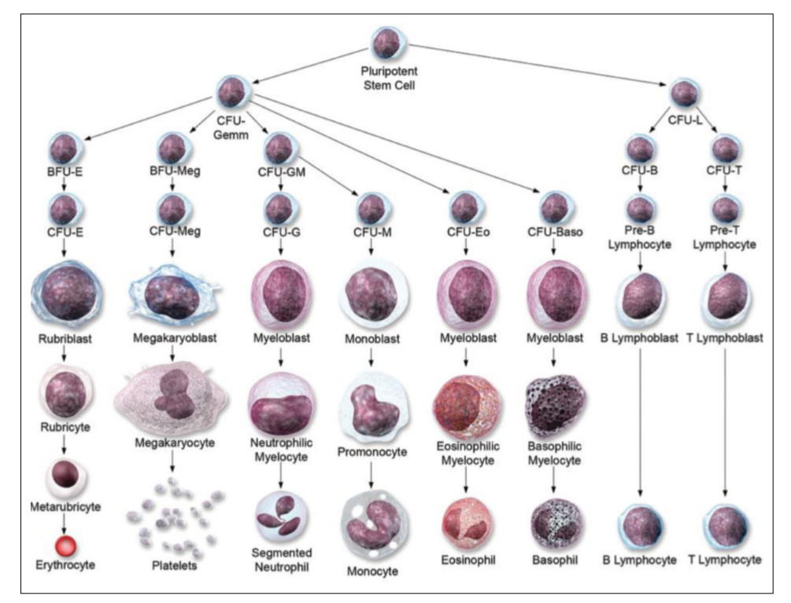
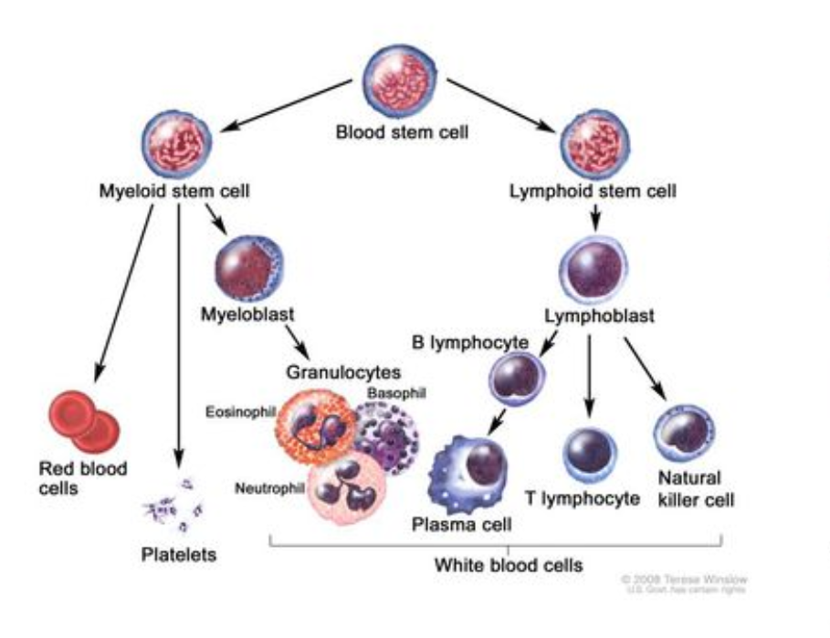
Heterogeneity examples
Blood samples
Image credit: Barreto et al., Journal of Pharmacy Practice 27(5):440-446, (2014)

Slide 7
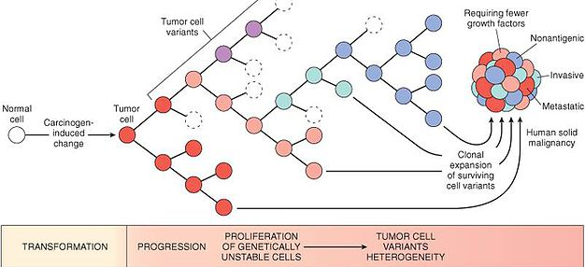
Heterogeneity examples
Tumor heterogeneity
Image source: http://patogeralpunf.wixsite.com/generalpathology/neoplasms

Slide 8
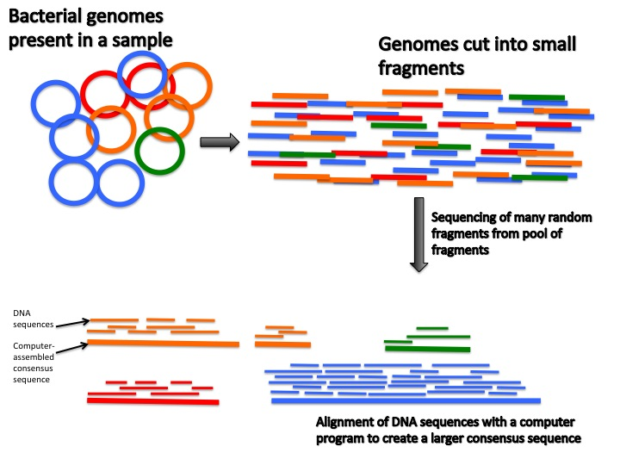
Heterogeneity examples
Metagenomics
Image source: https://teachthemicrobiome.weebly.com/sequencing-the-microbiome.html

Slide 9
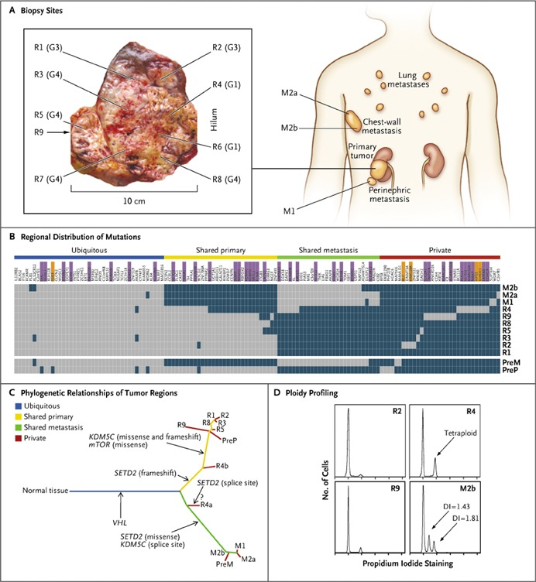
Intermediate solution
Multi-tissue sequencing
Questions:
How many tissues?
Which tissues?
How to know whether the decisions are good?
What if the sample is too small?
Image credit: Gerlinger et al., New England Journal of Medicine 366(10):883-892, (2012)

Slide 10
Challenges
Pushing the multi-tissue sequencing idea to the extreme, individual single cells are sequenced
Main difficulties:
Isolating single cells
DNA amplification
Data processing
Quality control, error correction and bias removal

Slide 11
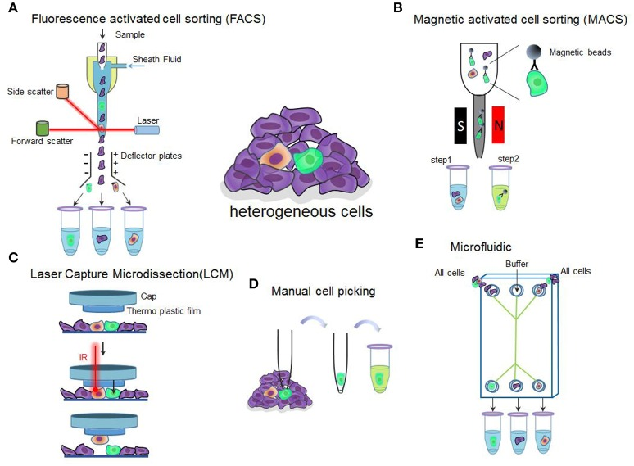
Single-cell isolation
Image credit: Hu et al., Frontiers in Cell and Developmental Biology 4:116, (2016)

Slide 12
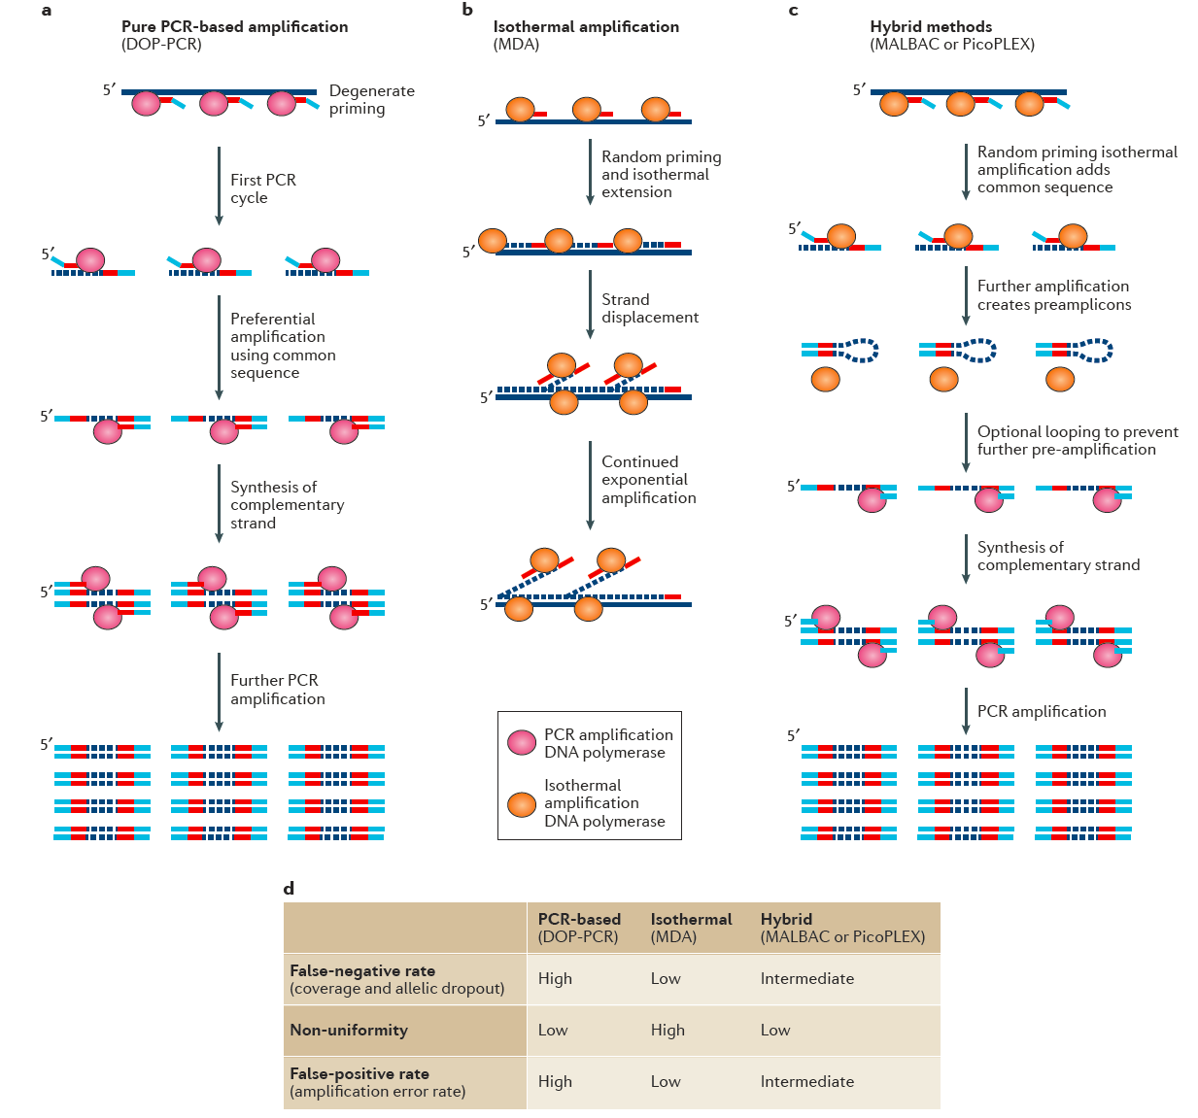
Amplification
Example: whole-genome amplification
Image credit: Gawad et al., Nature Reviews Genetics 17(3):175-188, (2016)

Slide 13
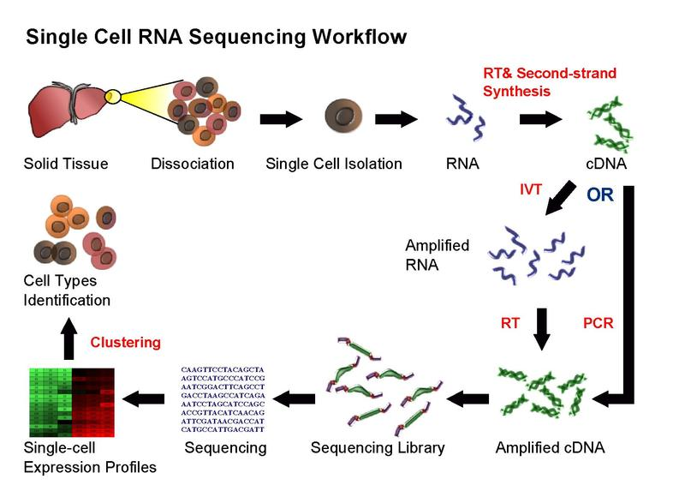
Single-cell RNA-seq
Image source: Wikipedia

Slide 14
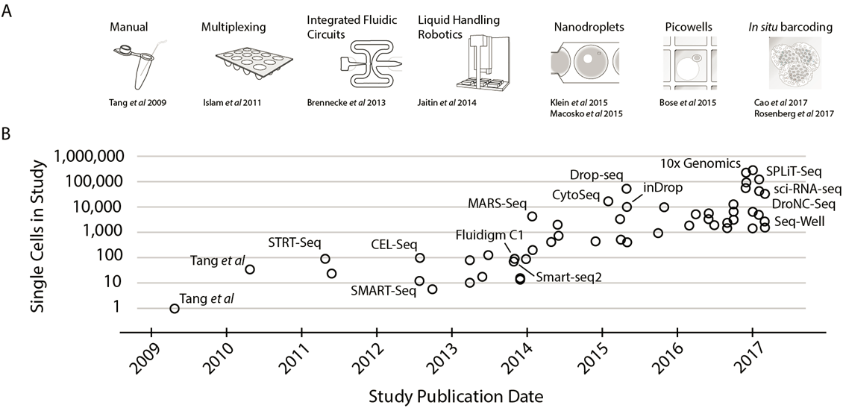
Throughput
Image credit: Svensson et al., arXiv :1704.01379v2, (2017)

Slide 15
Issues of resulting data
Bias in captured cells
Non-uniform amplification
Mixing data from different protocols
Amplification of errors
Allele dropout
Sampling bias of DNA fragments

Slide 16
Computational Methods for Processing and Analyzing Single-Cell Sequencing Data

Slide 17
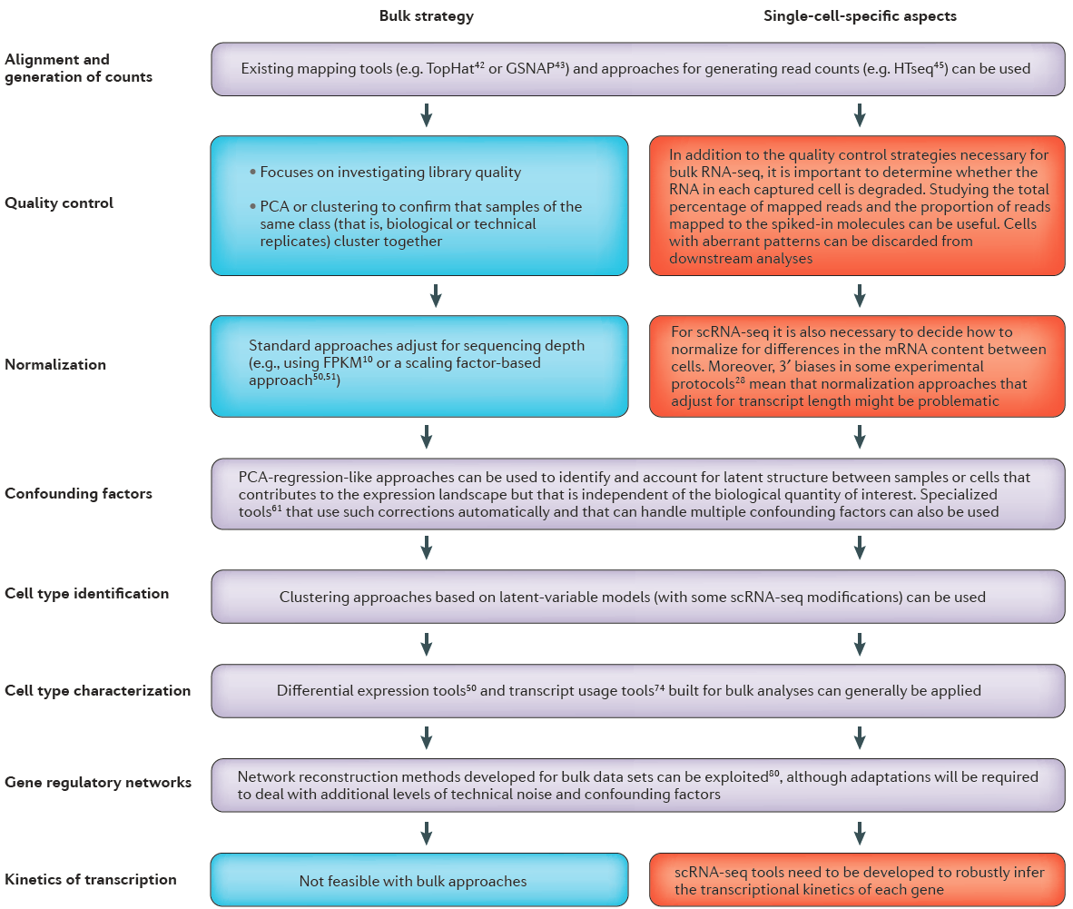
Processing pipeline
Image credit: Stegle et al., Nature Reviews Genetics 16(3):133-145, (2015)

Slide 18
Quantitative standards
Spike-ins: artificial RNAs/RNAs from another species with known quantity
External RNA Control Consortium (ERCC) set: 92 synthetic spikes based on bacterial sequences
Unique molecular identifiers (UMIs): short (6-10nt) DNA sequences for barcoding molecules of interest before amplification

Slide 19
Quality control
Standard steps for NGS/RNA-seq
Base quality
Nucleotide composition
k-mer counts
Read trimming
Read lengths
Alignment rate
Duplication rate
Contamination
Sample mix-up
Batch effects
Reproducibility based on replicates
...

Slide 20
Quality control
Comparing with quantitative standards for evaluating biases
Amplification bias
3’ bias
RNA degradation
Checking the total number of aligned reads and proportion of spike-in reads
Checking similarity among single cells
Looking for outliers
Comparing with bulk sequencing results

Slide 21
Quantification
Quantification measures such as RPKM and FPKM do not work well for scRNA-seq due to:
Low read counts, large sampling error
Dropouts
Different cell sizes/transcript levels in different cells
Additional types of bias
3’ bias makes normalization by transcript length not appropriate
More common to use a certain form of normalized absolute count

Slide 22
Normalization
Strategies:
Fraction of reads mapped to endogenous RNA: normalization across samples
Size factor for spike-ins: adjusting for sequencing depth
Size factor for endogenous RNAs: adjusting for cell size
Number of distinct UMIs for each gene: unaffected by amplification bias
Further adjusting based on spike-ins
Normalization across genes
If the focus is relative expression levels among cells

Slide 23
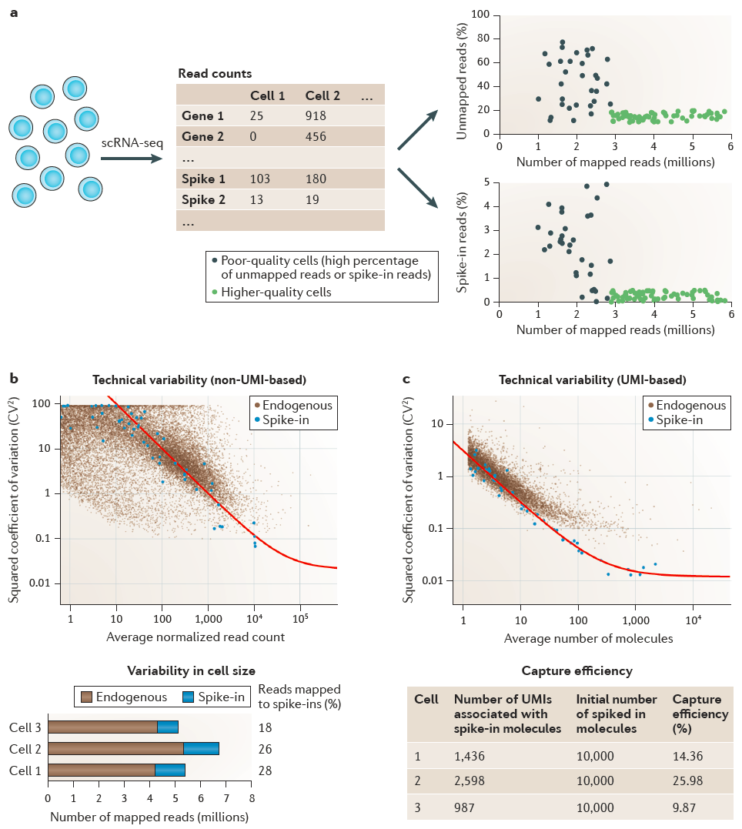
Normalization
Image credit: Stegle et al., Nature Reviews Genetics 16(3):133-145, (2015)

Slide 24
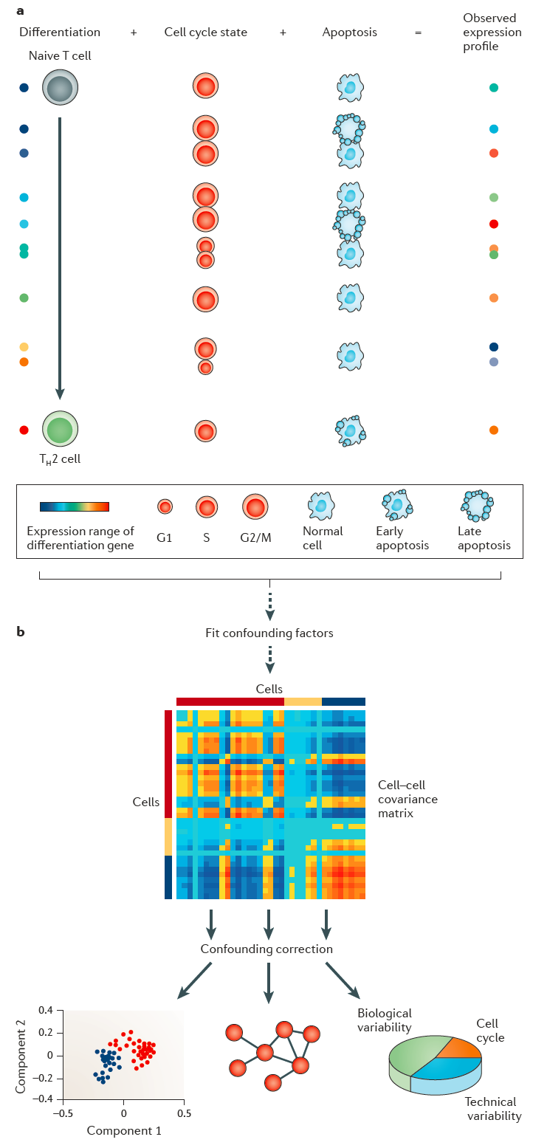
Confounding factors
Image credit: Stegle et al., Nature Reviews Genetics 16(3):133-145, (2015)

Slide 25
Dimension reduction and clustering
t-Distributed Stochastic Neighbor Embedding (t-SNE)
Minimizing the KL-divergence between cell-cell similarity in the original space and the reduced (usually 2D) space
Similarity between two cells in the original space: modeled by Gaussian distribution
Similarity between two cells in the reduced space: modeled by a Student-t distribution

Slide 26
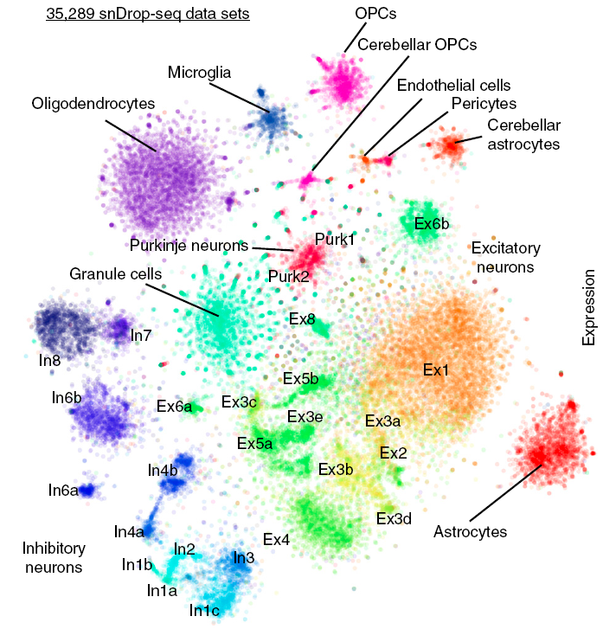
t-SNE example
Image credit: Lake et al., Nature Biotechnology 36(1):70-80, (2018)

Slide 27
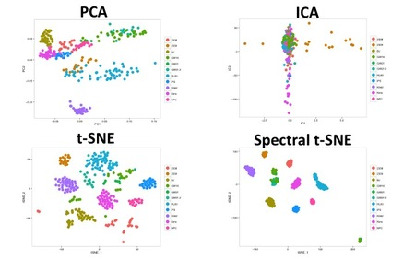
Comparing with other methods
Image source: http://satijalab.org/seurat/get_started_v1_2.html

Slide 28
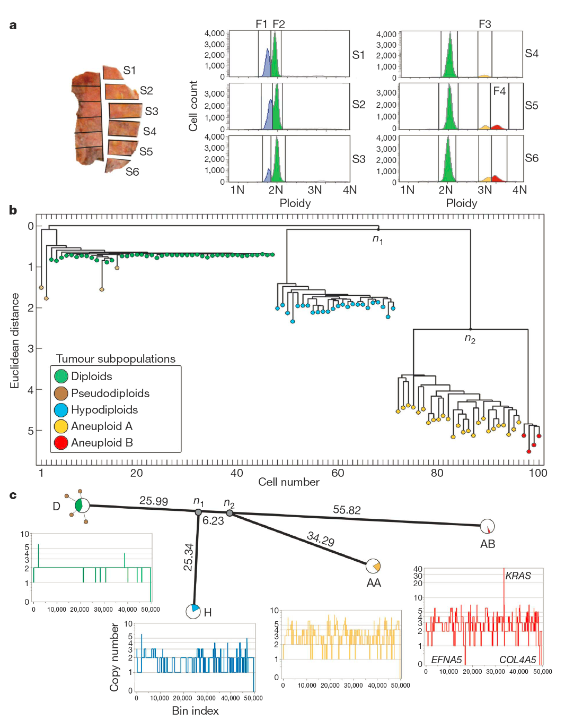
Hierarchical clustering
Image credit: Navin et al., Nature 472(7341):90-94, (2011)

Slide 29
Consensus clustering
Some clustering methods are not very robust and could produce very different clusters with different:
Parameter values
Initializations
Sampling of data points
Randomness of the clustering procedure
One way to deal with it is to repeat with many settings in parallel and combine the results

Slide 30
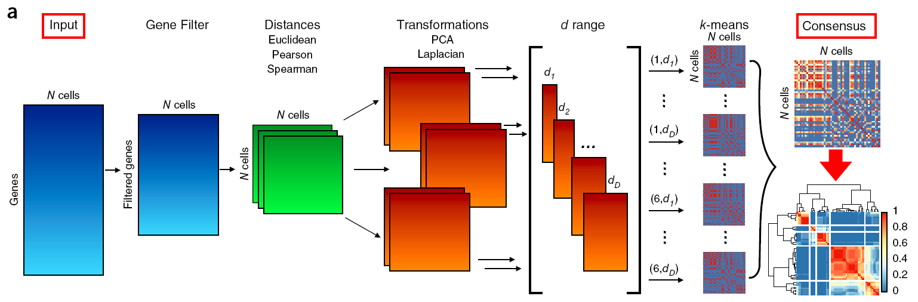
Consensus clustering
Image credit: Kiselev et al., Nature Methods 14(5):483-486, (2017)

Slide 31
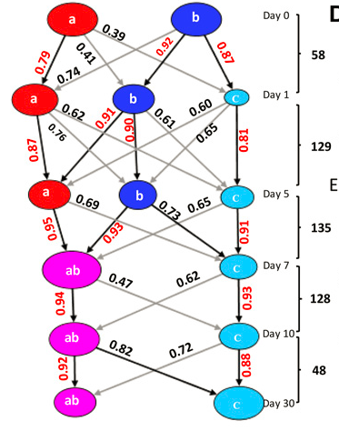
Mapping cell types/clusters across time
Image credit: Wang et al., Genome Research 27(11):1783-1794, (2017)

Slide 32
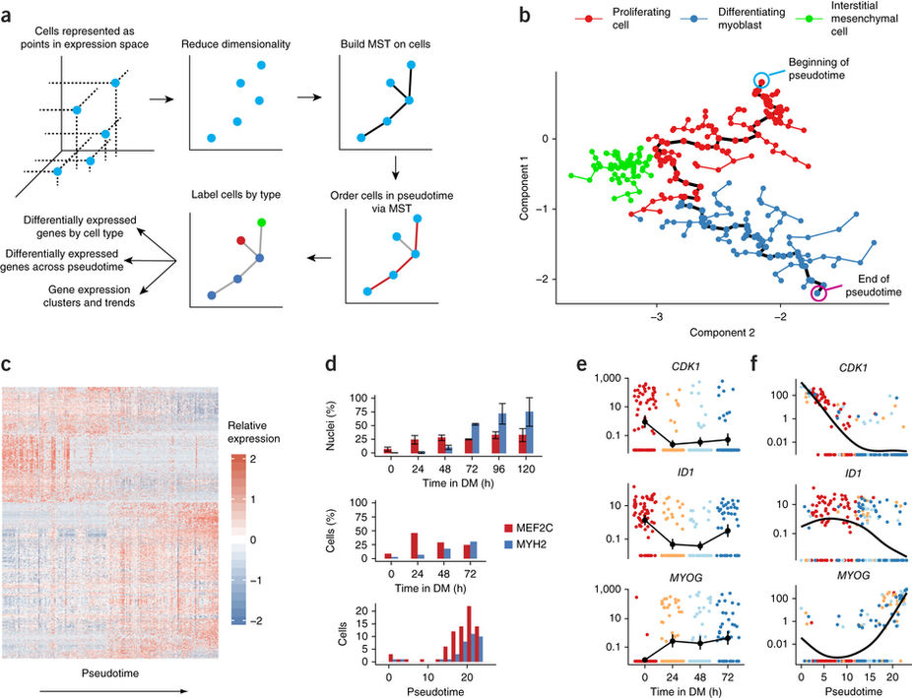
Pseudo-time trajectories
Ordering of cells (e.g., by polygonal reconstruction)
Image credit: Trapnell et al., Nature Biotechnology 32(4):381-386, (2014)

Slide 33
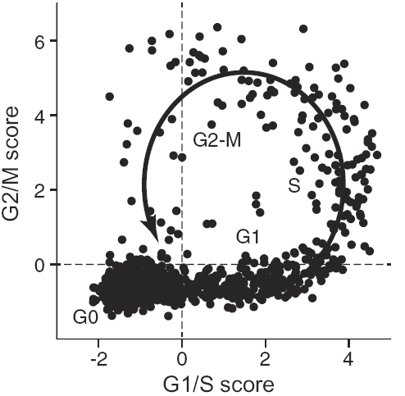
Pseudo-time trajectories
Image credit: Kowalczyk et al., Genome Research 25(12):1860-1872, (2015)

Slide 34
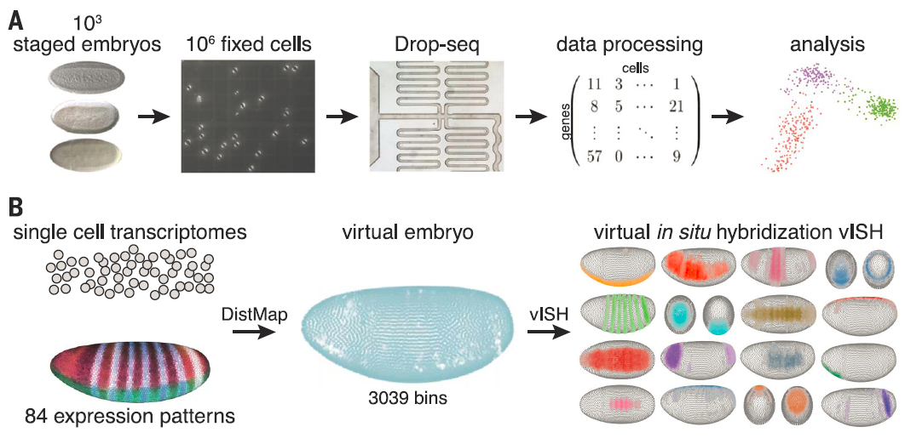
Spatial mapping of single cells
vISH: virtual in situ hybridization
Image credit: Karaiskos et al., Science 358(6360):194-199, (2017)

Slide 35
Other analyses
Identifying differentially expressed genes
Identifying marker genes
Identifying outlier cells
Reconstructing regulatory networks
Studying kinetics of transcription
Burst size and burst frequency
Studying patterns of stochastic gene expression
Correlating with other levels of information
Genetic variations
Allele-specific expression
DNA accessibility
DNA methylation
...

Slide 36
Validation of analysis results
Comparing with known cell type/stage-specific markers
Expression in bulk samples
FISH in individual cells
Time-lapse microscopy data
Within-cluster similarity

Slide 37
Summary
High-throughput single-cell sequencing
Main challenges
Single cell isolation
Amplification
Processing
Types
Single-cell RNA-sequencing
Quality check, error correction, bias removal
Downstream analysis

Slide 38
Aim & Objectives

Slide 39
Aims
Organize data from single cell transcriptome (SCT) data files (10X technology).
Develop ontology of human cell types.
Develop AI based classification models for various cell types and their states.
Validate those models with experimental data reported elsewhere.
Implement a system for assessment of anonymous file for each individual cell.
Explore the use of this system for potential blood testing.

Slide 40
Methodology

Slide 41
1. Raw SCT data collection and pre-processing.
2. Metadata construction and reference genome assembly building.
3. Feature selection/extraction.
4. Machine learning (ANN) training model building and optimization of model structure and parameters.
5. Case studies on different samples.
6. Set up a computational system.
7. Testing with new updating SCT data sets.
8. Diagnostic applications.

Slide 42
A typical single-cell RNA-seq analysis workflow using unsupervised machine learning methods for one study at a time

Slide 43
The problems with unsupervised methods
Data used in supervised learning is known and labeled (the class is known), while unsupervised learning it is not.
Number of classes is unknown.
(3) Accuracy of unsupervised learning is low.
(4) Low sensitivity for highly dimensional data.

Slide 44
Supervised learning can be used for diagnostic purposes
However, we need to know the exact class of data subset and have the ontology of classes.
We have collected, standardized and labeled ~1,500 files mainly from mouse and humans, and demonstrated a proof of concept that SCT data are classifiable.
The overall goal of this project is to develop a system that will enable users to perform automatized analysis of SCT data.

Slide 45
Our single-cell RNA-seq analysis workflow using supervised machine learning methods
ML step
~1,500 files done,
1 model verified.
The green parts are the topics of this project.

Slide 46
Progress

Slide 47
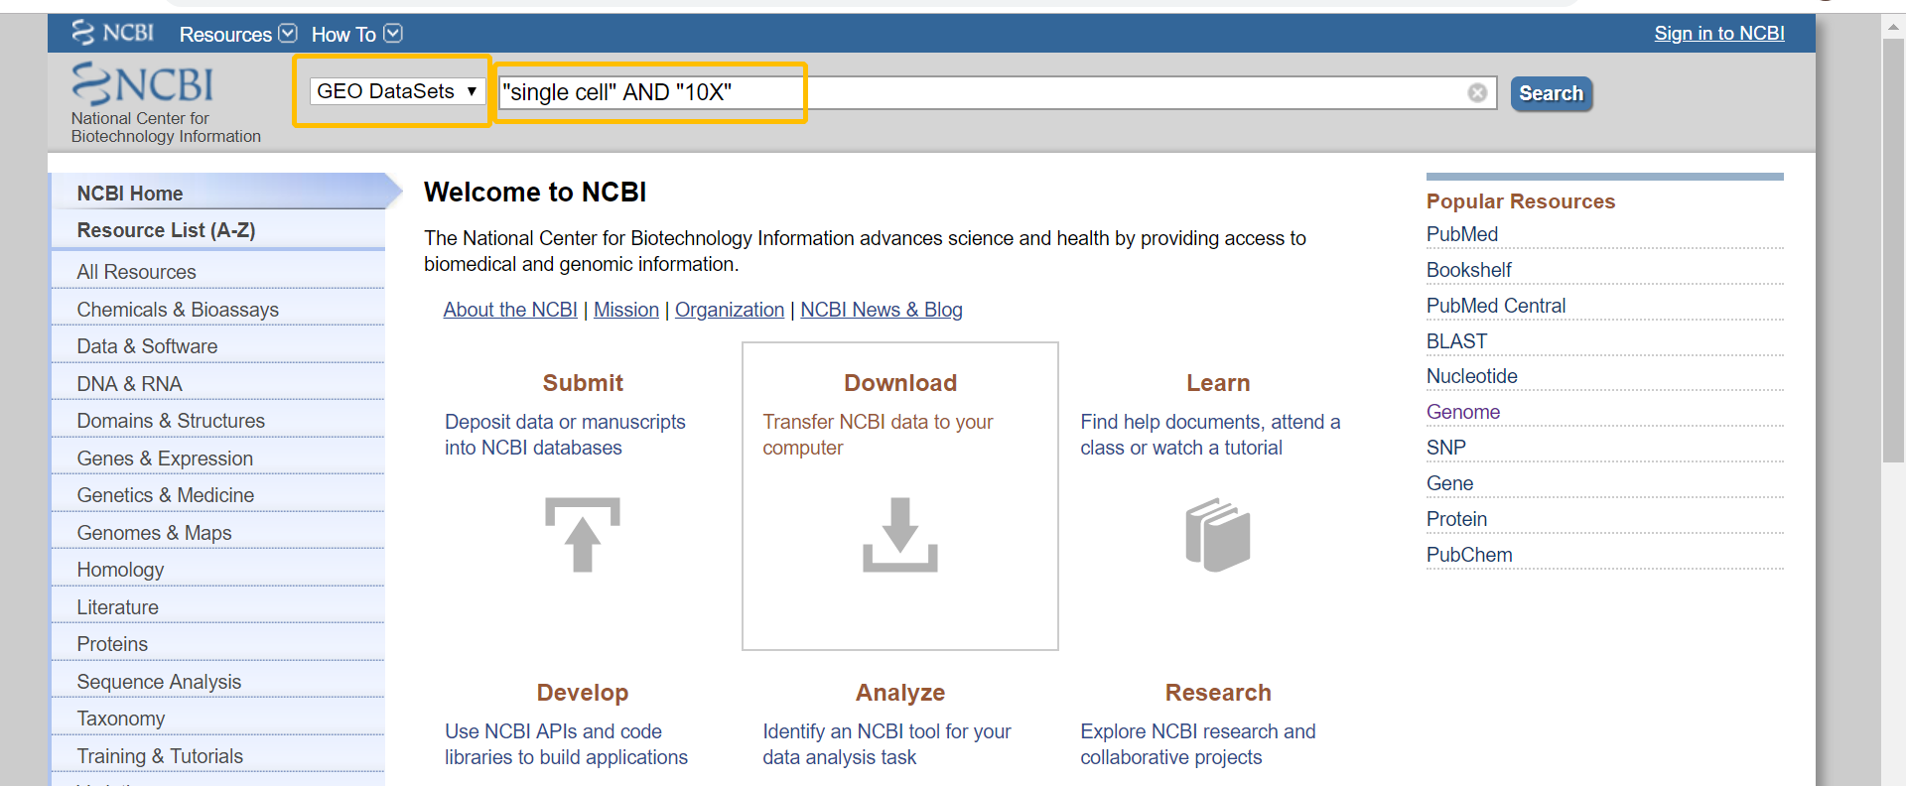
1 Raw data collection (over 1,500 files)
GEO database (GENE EXPRESSION OMNIBUS) https://www.ncbi.nlm.nih.gov/
Single cell gene sequencing & 10X

Slide 48
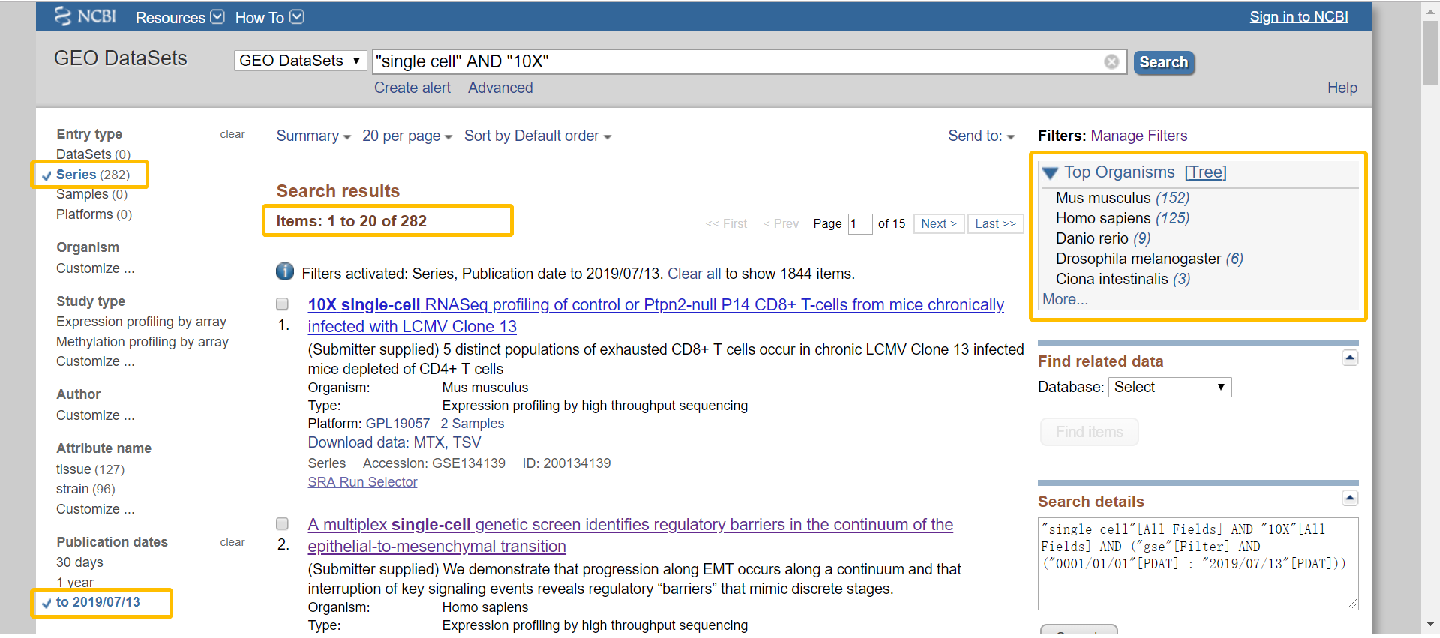
From the relevant articles published by 13/07/2019

Slide 49
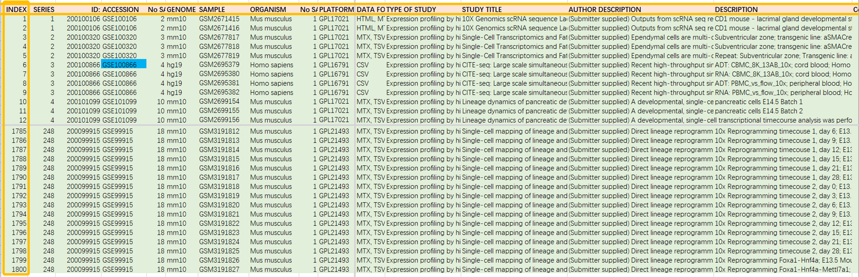
2 Metadata construction
The metadata has 248 series mapped with 1809 samples, the description of each study is involved in the metadata and some of them has additional comments.
①

Slide 50
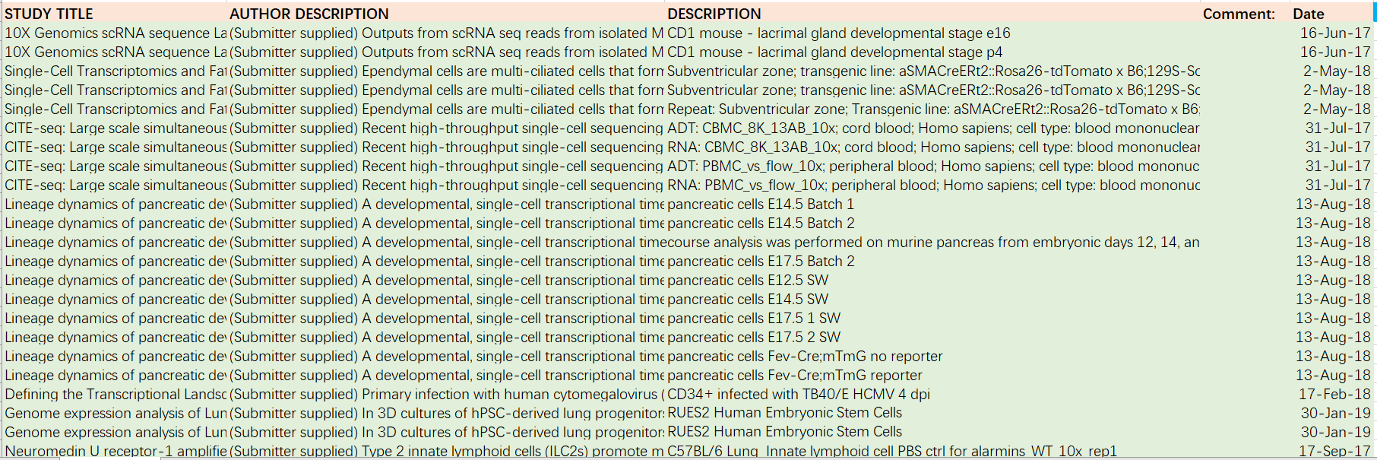
②

Slide 51
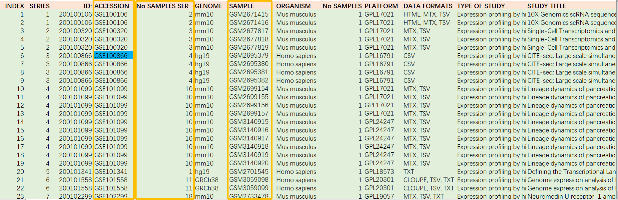
Components of Metadata

Slide 52
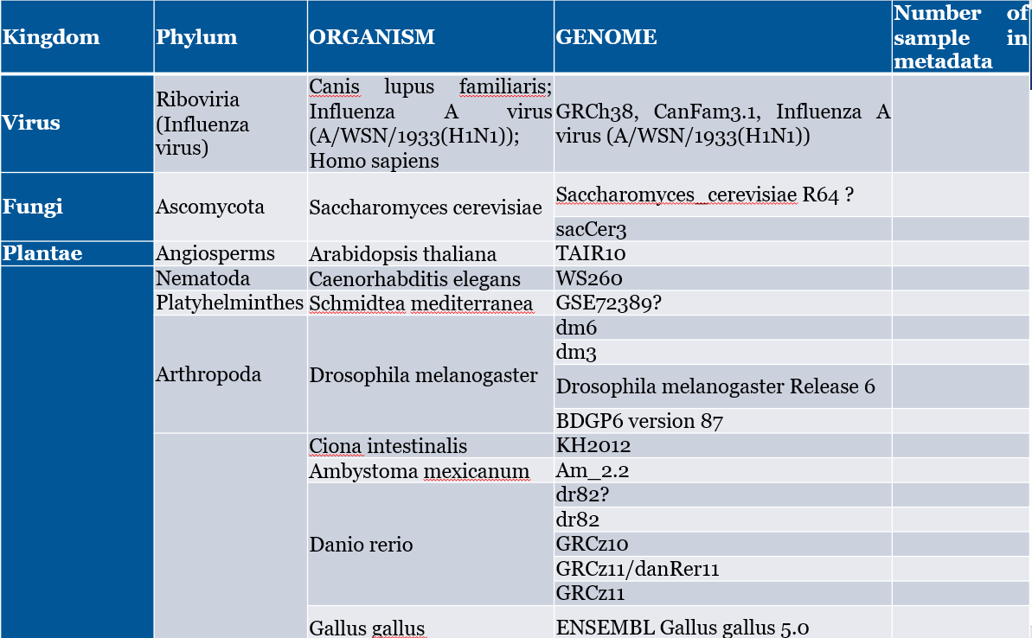

Organism - totally has 15 different kinds of
Table 1. 1. Total organisms and versions of genome in the metadata. Part 1.

Slide 53
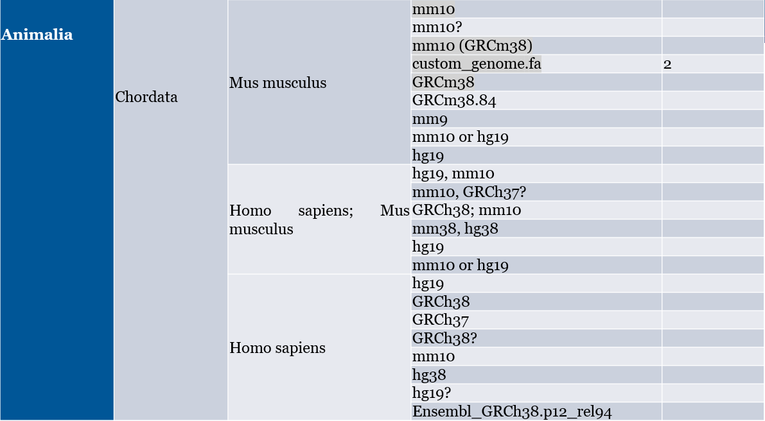
Table 1. 2. Total organisms and versions of genome in the metadata. Part 2.

Slide 54
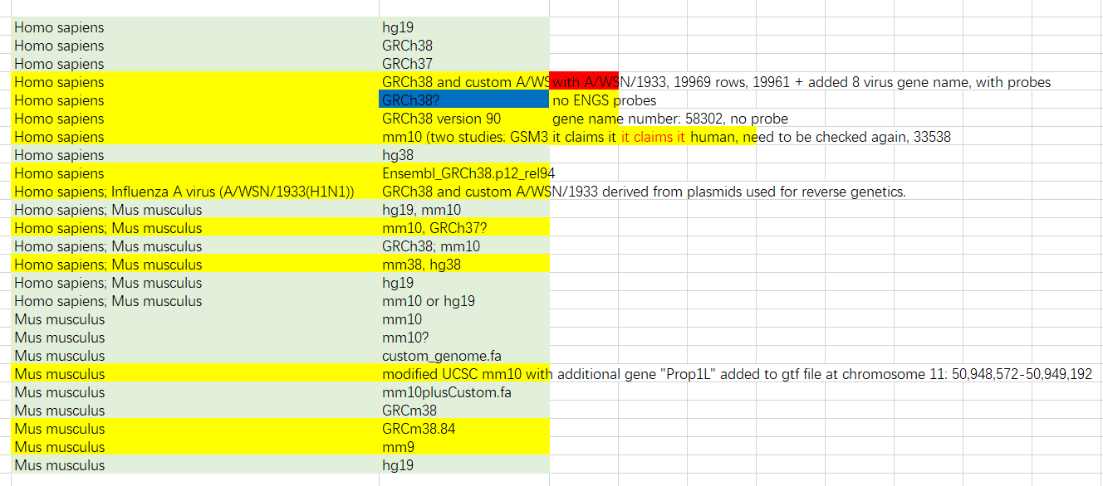
Do comparative analysis to different alternative genome of human and mouse.

Slide 55
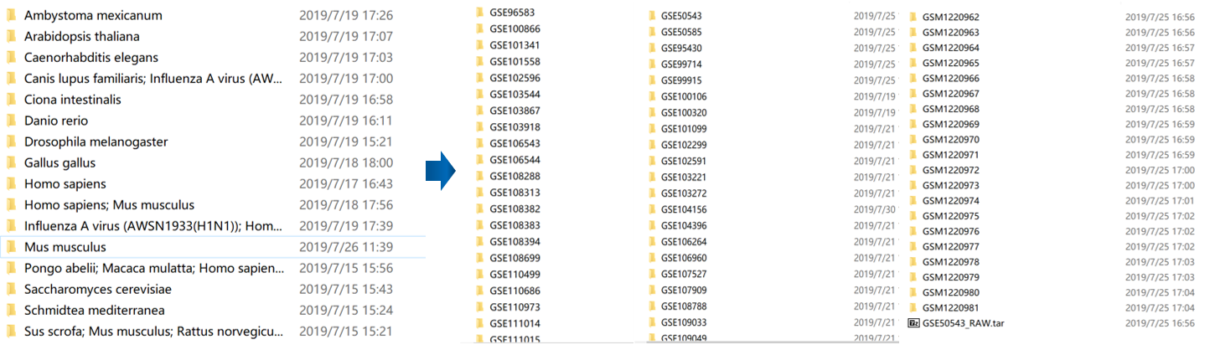
3 Quality control
Studies which are not related but filtered by GEO browser with the key words are excluded. Series who have an inconsistent description of their studies are excluded out as well.
4 Data pre-processing (Data cleaning, filtering and standardization)

Slide 56
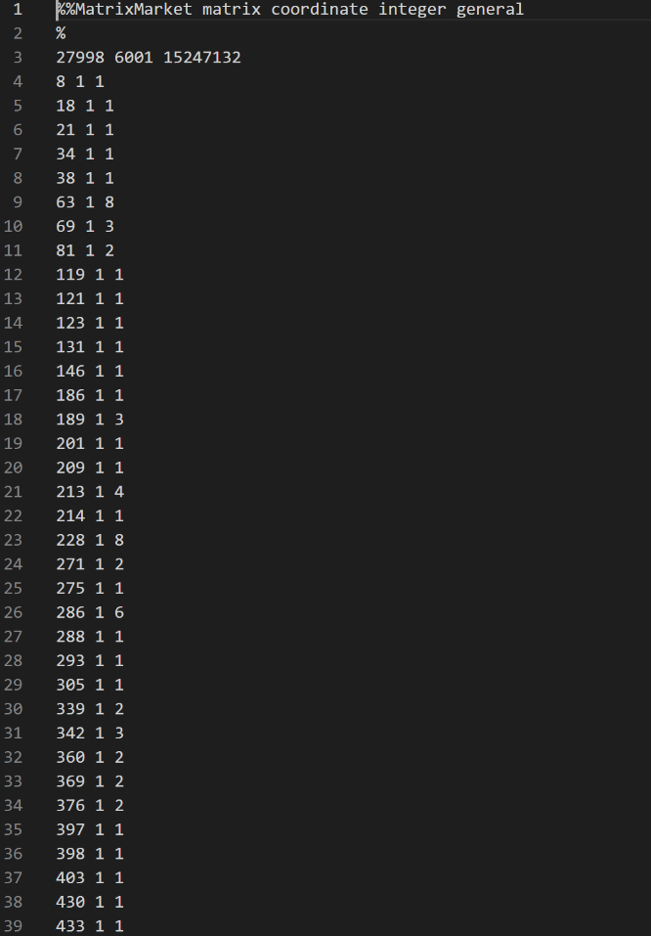
Data conversion
MTX file needs to be converted to CSV file for better visualization.

Slide 57
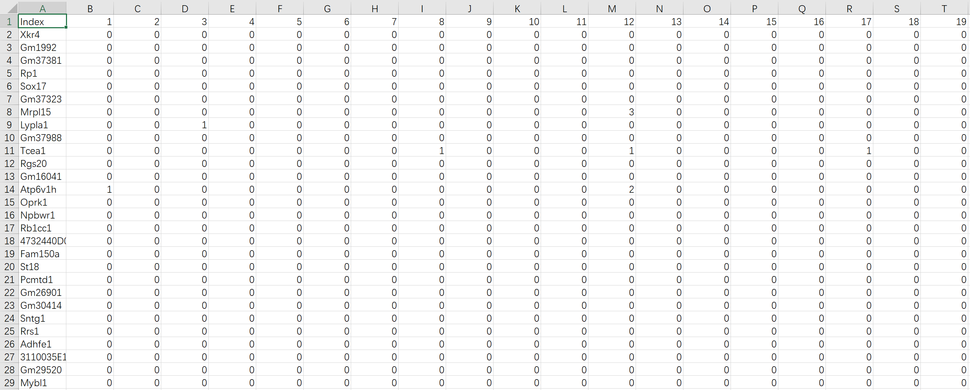
Data matrix for one sample as an example.

Slide 58
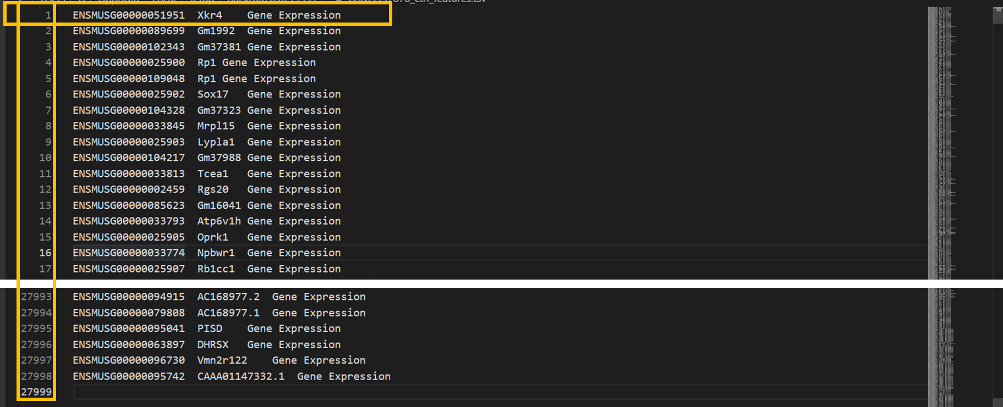
5 Reference genome assembly selected and built

Slide 59
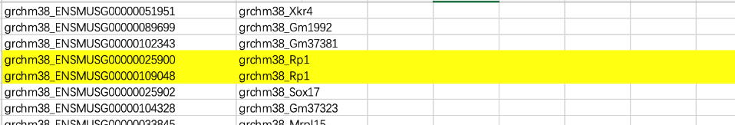
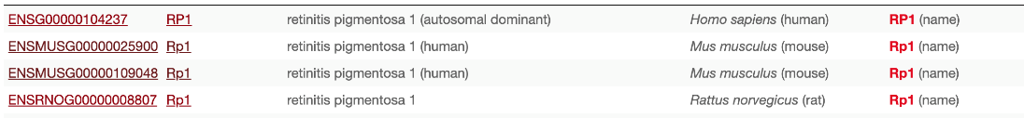
An example for the same gene name with different probe numbers in one genome version (GRCm 38).

Slide 60
Components of common list (reference genome assembly) and full list for Mouse and Human.
 | Component | Common list probes number | Full list probes number | Note
Mouse | “grchm38_GSE132199.tsv” “mm10_2_GSM2928504_GSE109049.tsv” “mm10_3_GSM3272966_GSE117176.tsv” “mm10_4_GSM3937878_GSE134139.tsv” “mm10_5_GSM3537044_GSE124577.tsv” ... ... (special genome) | 27998 | 28693 | “mm10_1_GSM2671415_GSE100106.tsv” Deleted. (Not clear version.)
Human | “grch37_1_GSM3073089_GSE112570.tsv” “grch38_1_GSE117403.tsv” “grch38_2_GSM3375767_GSE119506.tsv” “grch38_3_GSM3478791_GSE122703.tsv” “grch38_4_GSM3543618_GSE124703.tsv” “grch38_5_GSM3813936_GSE131685.tsv” “hg19_2_GSM3430548_GSE121267.tsv” “hg19_3_GSM3635372_GSE127471.tsv” “hg19_4_GSM2897333_GSE108394.tsv” ... ... (special genome) | 30710 | 60570 | “hg19_1_GSM2867931_GSE106245.tsv” “hg19_5_GSM3143601_GSE114530.tsv” Deleted. (Decimal point, date format error, version error.)

Slide 61
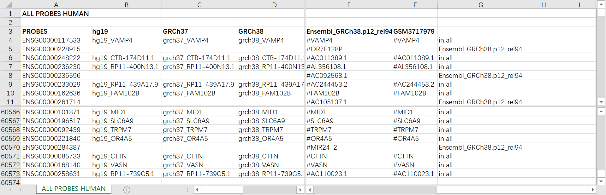
Full list of Human genome, Ensembl probes with the mapping to different genome versions.

Slide 62
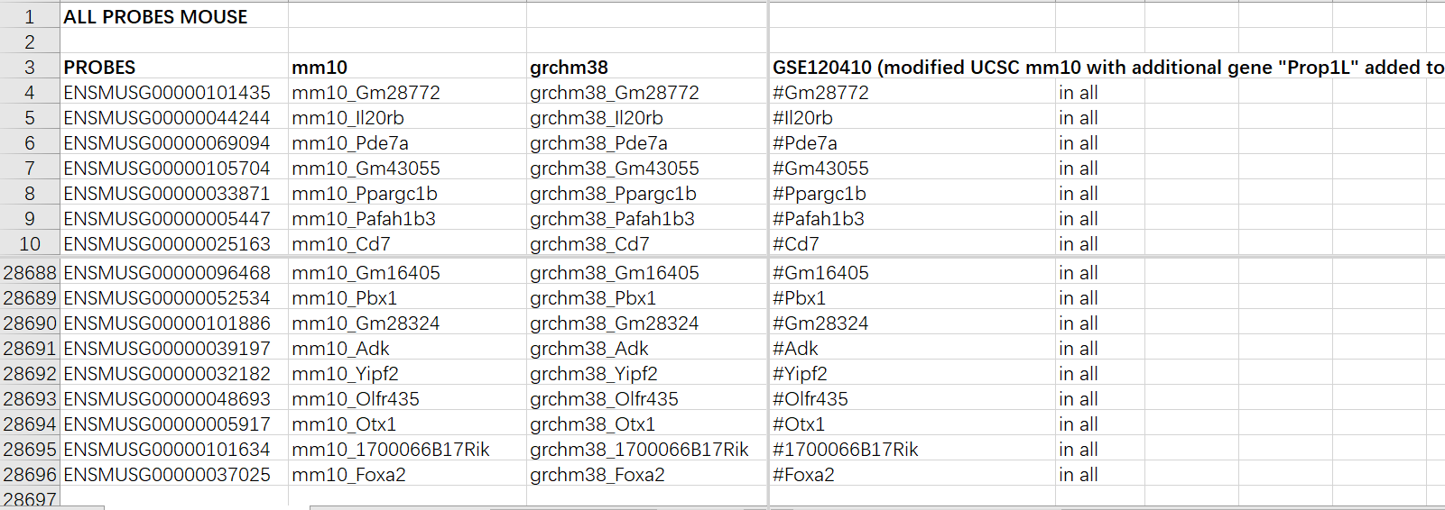
Full list of Mouse genome, Ensembl probes with the mapping to different genome versions.

Slide 63
6 Case study
A case study on classification of five cell types from PBMC samples have been submitted to BIBM.

Slide 64
Conclusion

Slide 65
In our project, around 2,000 SCT data files have been collected,
cleaned and standardized, with metadata constantly updating.
2. Reference genome assembly has been built.
3. Refined cell ontology still needs to be cleared.
In PBMC blood sample case study, the accuracy of cell recognition and
classification is 90%, much more accuracy still needs to be achieved for realistic
clinical implementation.
Optimization feature extraction methods and training model structure and
parameters needs to be found.
The overall goal of this project is to develop a system that will enable users to
perform automatized analysis of SCT data.

Slide 66
Project plan

Slide 69
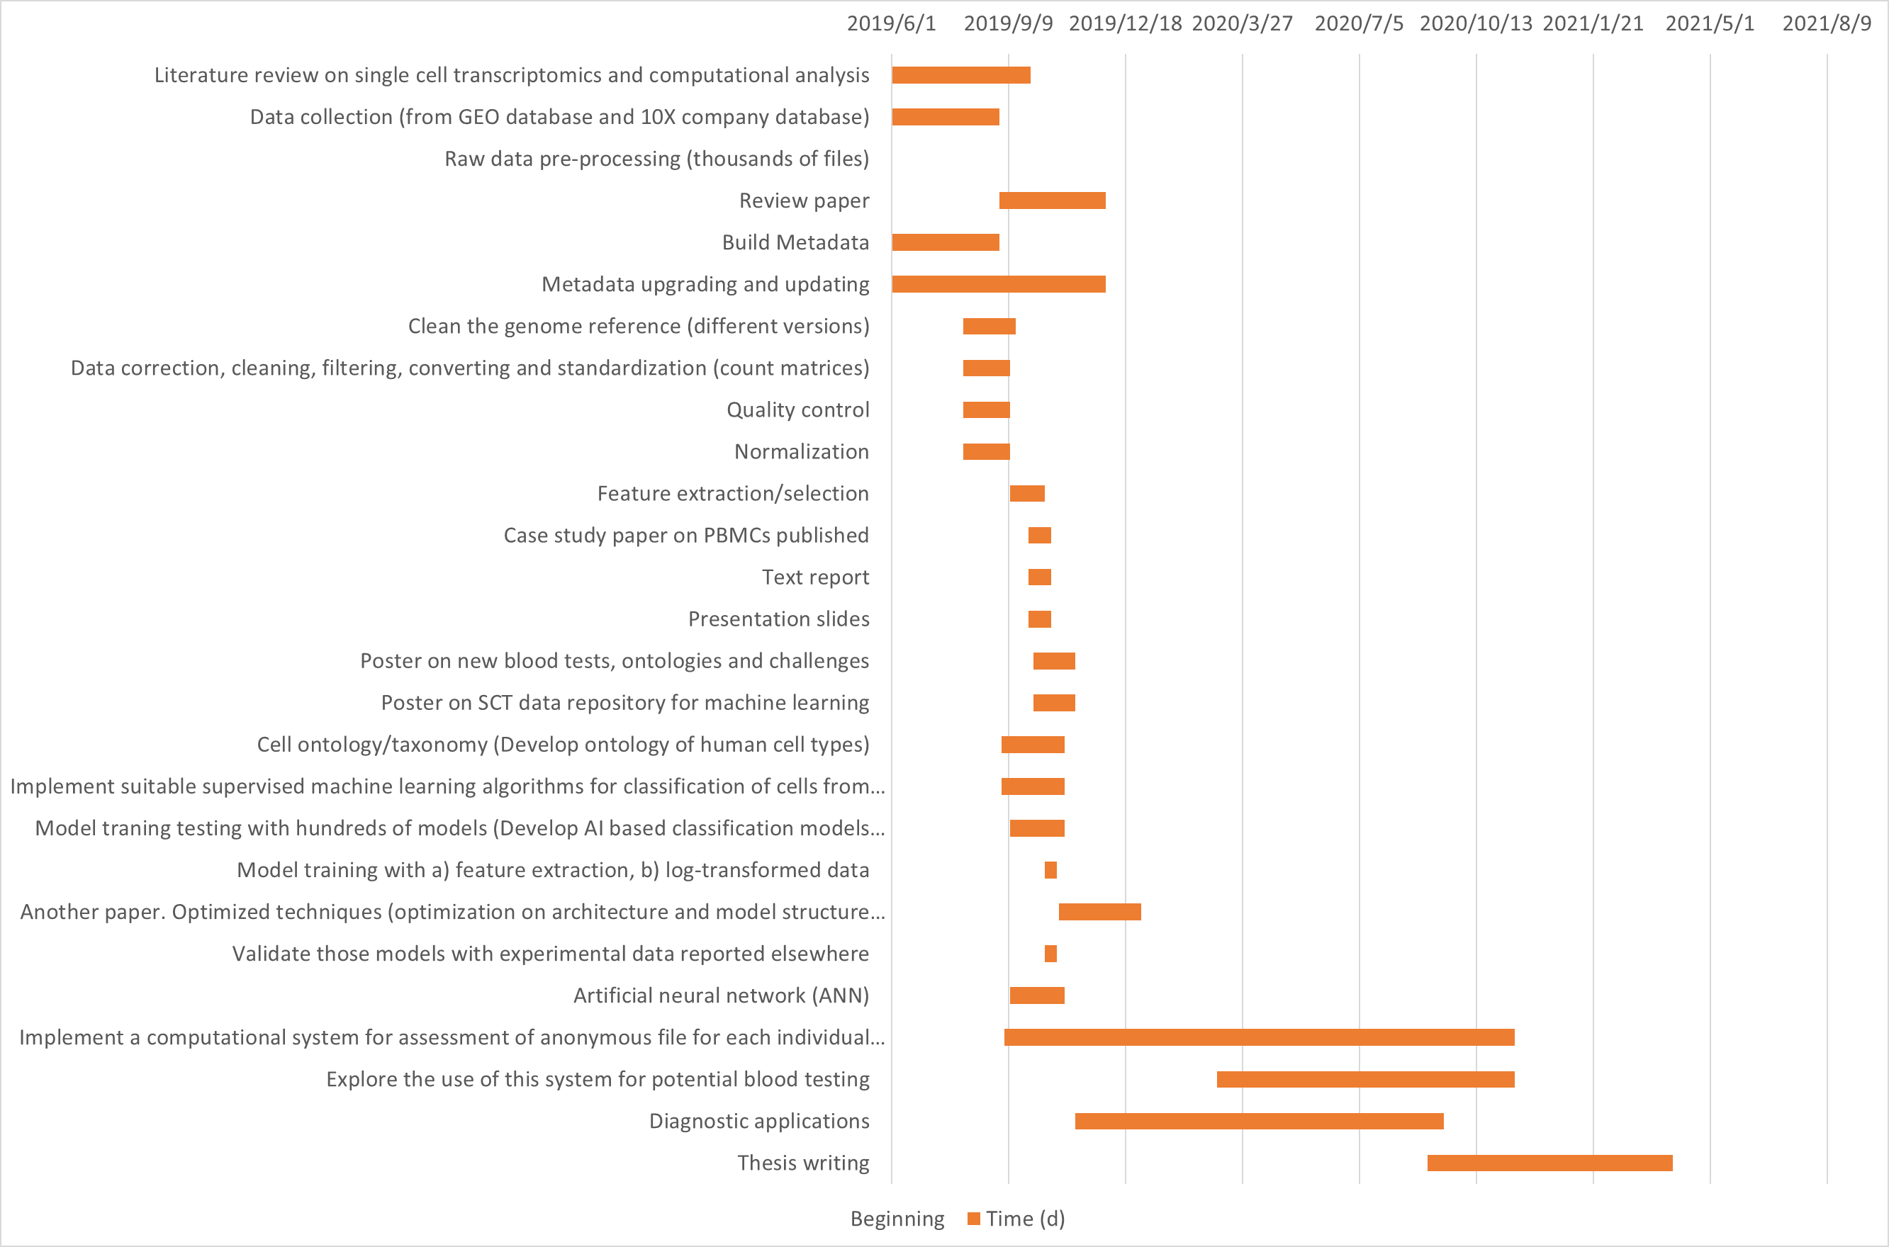

Slide 70
Appendix 1

Slide 71
Comments and actions

